Slide 1
Spanish Flu of 1918 and Mortality Impact in the United States
Student’s Name
University Department
Course Number/Name
Professor’s Name
Date

Slide 2
Introduction
The world has experienced various apocalyptic events
This includes the Spanish Flu of 1918
Even though there have been various cases of influenza flu
The Spanish flu was not like any other flu ever witnessed
The main difference was the number of deaths it caused
In the United States, the death toll rose to more than half a million people
Notes:
I want to begin my presentation with brief insight on the apocalyptic event that I am going to examine, the Spanish Flu of 1918 of Influenza. This presentation will look at the demographical impact of Spanish flu of 1918 in the United States as well as compare it with the Covid-19 that we are experiencing today.

Slide 3
Spanish Flu of 1918
The Spanish Flu was not like any influenza case the world ever experienced before or even after
Documentation shows that it was the deadliest pandemic that hit the whole world
The significance of this pandemic can be remembered through the statistics of death toll
Worldwide, the death toll rose to more than 50 million people (CDC, 2019; Schelden,2020; Saul, 2018)
This was severe than anything ever witnessed
Notes:
Based on the documentation, it is evident that the Spanish Flue was nothing like the world has ever witnessed. This has been confirmed by the statistics on the number of people that succumbed to the disease. It is estimated that the death toll was between 50 to 100 million people across the world. Following the low number of population of the world that time, something that could claim the death of more than 50 million was more apocalyptic than even the World War I.

Slide 4
The Flu in the United States
The United States was one of the hardest hit countries
More than 675,000 people lost their lives to this flu (CDC, 2019)
Barry and Dickerson (2020) provide a narrative to explain the impact of this flu
They say that the flu crippled the U.S. in the middle of another apocalypse, World War I (Barry & Dickerson, 2020)
In Philadelphia, more than 17,500 people died (Barry & Dickerson, 2020)
Notes:
It is important to note that Spanish Flu crippled the United States’ population. One of the places that the flu hit was Philadelphia where it claimed the lives of more than 17,500 people in the first six months (Barry & Dickerson, 2020). Every experience documented regarding this flu is terrifying.

Slide 5
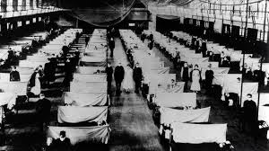
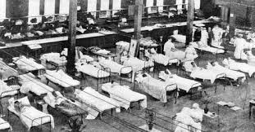
What the Situation was like
After the breakout of the flu, the situation was bad as seen in the following photos
Notes:
The number of people hospitalized increased in the first six months of the pandemic and as shown in the photos, the healthcare system was overwhelmed. No one could have predicted the level of severity that the flu could have caused on the healthcare system.

Slide 6
The Cause of Spanish Flu
The Spanish flu was a unique type of influenza
Several closely related viruses are associated with influenza
However, the Spanish flu was caused by one particular virus, H1N1 type A virus (Saul, 2018)
The flu was severe because it was not well understood
The higher fatality rate is another thing that made it unique from other influenza viruses (Matthewa, 2020)
Notes:
The Spanish flu was unique and from what we can gather from documentation, it was different from other types of influenza viruses that the world had experienced. Matthews (2020) highlights some of the flu cases ever experienced including the Asian flu of 1957 and Hong Kong flu of 1968, all which did not match the Spanish flu. The Spanish flu was a severe pandemic.

Slide 7
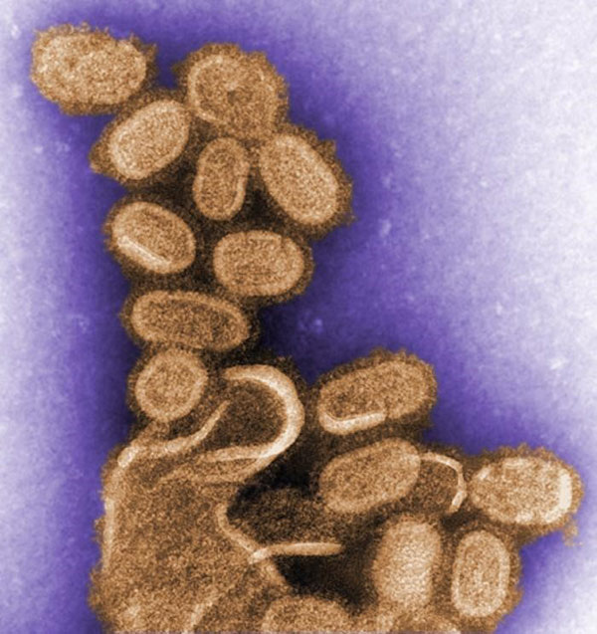

Comparing Spanish Flu and Covid-19
Notes:
The first photo presents the Spanish Flu and the second one presents the Covid-19 or coronavirus. Despite their physical structural difference, the two diseases have quite a number of common features, especially they all qualify as apocalyptic events due to the number of lives they have claimed. More comparisons follow in the next slides.

Slide 8
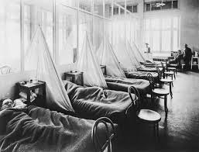
Continuation of Comparison
Each of these viruses tell us a story
One, no matter how advanced the healthcare system, it can be overwhelmed
The Spanish Flu was an evident case that the healthcare system can be overwhelmed
Even though the health
System had not advanced like
The ones we have today, but,
it showed a lesson to learn
Notes:
The Spanish flu was a great lesson to the world and it propelled the development and huge investments in the healthcare sector across the world, not only in the United States. The above photo shows a congested hospital room with limited bad capacity and equipment. Today, we may have advanced machines, but the numbers are still terrifying.

Slide 9
Covid-19 Cases
By 2020 April 1st, the world had recorded more than 921,924 cases of Coronavirus cases
The United States had confirmed more than 186,101 cases (Terry, 2020)
Further, the death toll in the U.S. during the same period was 3,603 (Terry, 2020)
Despite the advanced healthcare system today, Covid-19 seems to be as severe as the Spanish flu
Both flu cases are unknown to scientists, which makes it difficult to create vaccine
Notes:
Like the Spanish flu, the covid-19 cases are increasing slowly and as the statistics show, it could be severe if it is proper control measures are not taken early enough. The death toll in the United States have surpassed 3,000 and it continues to rise. Out advanced healthcare system in the world seems to do very little now that we continue to witness high number of people succumbing to this covid-19.

Slide 10
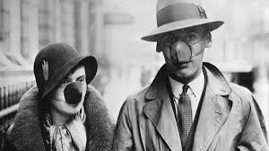
Mortality Rate
The mortality of both Spanish and Covid-19 are high
As evidenced in the fatality cases reported, the number of people succumbing to these diseases are high
Notes:
The CDC has established that the mortality rate with the Spanish flu was high and it was resulted in the death of millions of people worldwide and hundreds of thousands in the United States. The CDC further explains that the unknown properties of Spanish flu made it difficult to synthesize vaccine to protect against its infection (CDC, 2019).

Slide 11
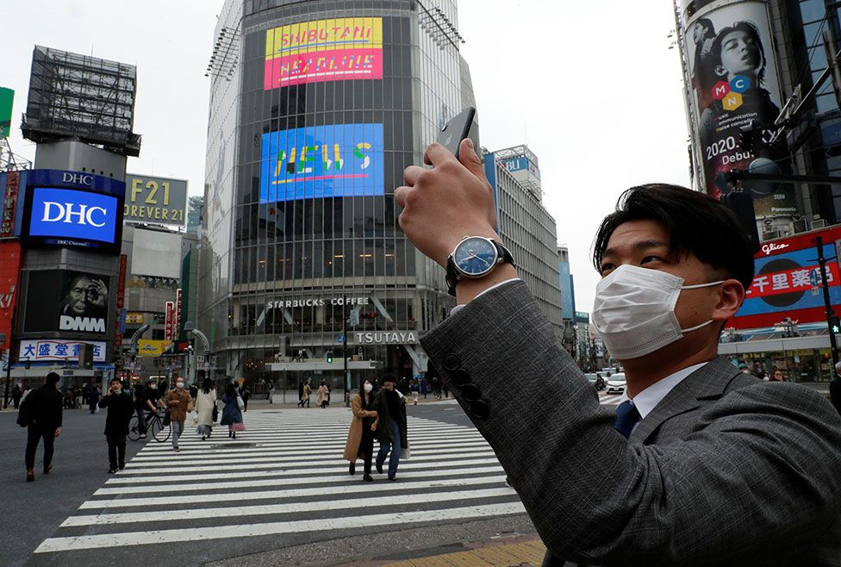
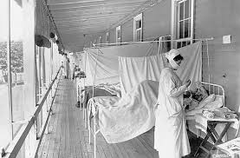
Continuation of Mortality
CDC (2019) explains that Spanish flu was high among two populations:
1. Children below 5 years old
2. Older people above 65 years old (CDC, 2019)
As such, the mortality of Spanish flu was exceptionally high (Noymer & Garenne, 2000).
Notes:
According to Noymer and Garenne (2000), normally influenza is lethal to very young and old people. For the these age groups, the cold that is usually associated with the flu may overwhelm their health conditions, which makes them more vulnerable to the virus. The current covid-19 pandemic that the world is facing today has also been linked to old and younger people due to their vulnerability of their health conditions. However, what is different with the Spanish flu and is here with the covid-19 is that people with the pre-existing conditions like chronic diseases are also exposed to greater threats.

Slide 12
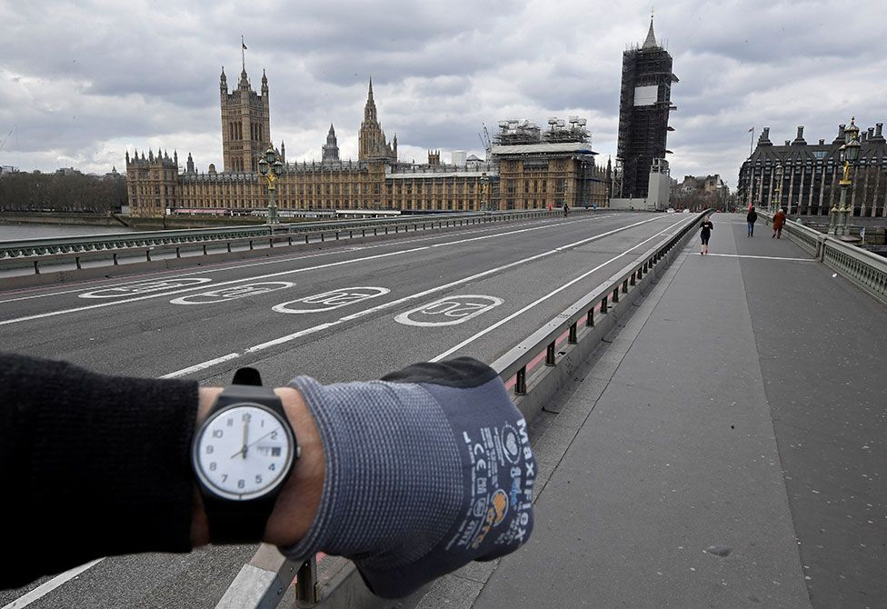

Massive Effects of Spanish Flu and Covid-19
As shown in the photo below, the streets are already emptied as a result of covid-19
This kind of response did not happen in the Spanish flu
Arguments have emerged that this difference may limit the death toll in the current pandemic
Notes:
As evidenced in the above photos, some of the governments have taken the measures to reduce the devastating impacts of coronavirus that was witnessed in the Spanish flu. The malls are today empty and people in the streets limited. Like any virus, both covid-19 and Spanish flu were transmitted through the same way; contact between people. Reducing this contact would significantly help in reducing the rate of mortality.

Slide 13
Conclusion
The Spanish flu of 1918 told a story of how a disease as simple as a flu can devastate the whole world
Evidenced from the number of people that died as a result of Spanish flu
One can only imagine the extent that the current covid-19 pandemic could create
Documented information on Spanish flu can help the United States:
1. Learn how to better control the current crisis
2. Protect its people from succumbing to this virus
Notes:
I want to conclude my presentation by stating that there is a lot of lessons to be learned from the Spanish flu and the current covid-19 pandemic case that the whole world is experiencing. Based on the numbers of victims, the United States is the worst hit country worldwide. If lessons are to go by, the government can pick some serious lessons including following the health expert guidelines to help prevent the spread and further mortality effects on the American population.

Slide 14
References
Barry, D., & Dickerson, C. (2020 April, 4). “The Killer Flu of 1918: A Philadelphia Story.” The New York Times. Retrieved from https://www.nytimes.com/2020/04/04/us/coronavirus-spanish-flu-philadelphia-pennsylvania.html
CDC. (2019 March, 20). “1918 Pandemic (H1N1 Virus).” Center for Disease Control and Prevention. Retrieved from https://www.cdc.gov/flu/pandemic-resources/1918-pandemic-h1n1.html
Matthews, D. (2020 March, 09). “Why we should be careful comparing the Covid-19 Coronavirus outbreak to the 1918 Spanish Flu.” Vox. Retrieved from https://www.vox.com/2020/3/9/21164957/covid-19-spanish-flu-mortality-rate-death-rate
Noymer, A., & Garenne, M. (2000). The 1918 influenza epidemic's effects on sex differentials in mortality in the United States. Population and Development Review, 26(3), 565-581.

Slide 15
Continuation of References
Saul, T. (2018 April, 03). “Inside the Swift, Deadly History of the Spanish Flu Pandemic.” National Geographic. Retrieved from https://www.nationalgeographic.com/history/magazine/2018/03-04/history-spanish-flu-pandemic/
Schelden, P. (2020 March, 12). “What 1918 Spanish Flu Death Toll tells us about Covid-19 Coronavirus Pandemic.” Medicinet. Retrieved from https://www.medicinenet.com/script/main/art.asp?articlekey=228841
Terry, M. (2020 April, 02). “Compare: 1918 Spanish Influenza Pandemic Versus Covid-19.” BioSpace. Retrieved from https://www.biospace.com/article/compare-1918-spanish-influenza-pandemic-versus-covid-19/

